Slide 1





HackOrbit 2025
Farm2Market

Slide 2

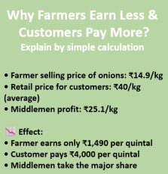
THEME & PROBLEM STATEMENT
Theme: Open Innovation in Agriculture using AI for Direct Crop Marketing and Price Intelligence
Current Issues Faced by Farmers:
80% of farmers rely on middlemen who reduce profit margins
No Direct access to buyers (households/restaurants)
Zero forecasting of price fluctuation or demand trends
Lack of awareness about subsidies & government schemes

Slide 3

PROPOSED SOLUTION
Our AI-powered platform is designed to empower small and marginal farmers by enabling them to sell their crops directly to local buyers—including households, restaurants, and small businesses—without the interference of middlemen.
By combining direct market access with an intelligent machine learning-based price prediction model, the platform equips farmers with real-time insights and future pricing trends, helping them make confident, data-driven selling decisions. This not only boosts their income 💰 but also promotes transparency and fairness across the agricultural supply chain.
Our Solution Ensures:
-> Increased profit margins by eliminating middlemen
-> Trust & transparency with verified listings and real-time data
-> Fair pricing for farmers through price forecasting

Slide 4
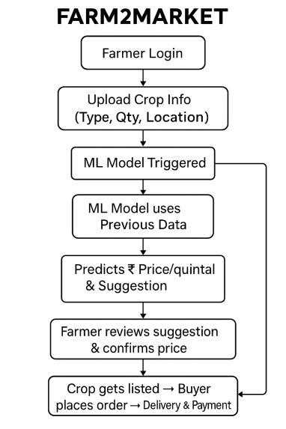
FLOWCHART / DIAGRAM
Login / Sign-Up
Farmers register on the FARM2MARKET website with basic details.
Upload Crop Details
Enter crop name, quantity, state , district , quality.
g
ML Price Prediction Triggered Automatically
Predicts ideal selling price + gives “Sell Now” or “Wait” advice. And also provide a graph.
Farmer Reviews Suggestion & Finalizes Price
Can follow the recommendation or set a custom price
Listing Goes Live
Crop is visible to nearby buyers (households, vendors, restaurants).
Buyer Places Order
Buyers view listing, check quality tags, and place orders.

Slide 5
Tech Stack
Machine Learning:
Linear Regression
Trained in Google Colab
Frontend (Client):
HTML, CSS, Bootstrap
JavaScript / jQuery / React
Backend (Server):
Flask for backend logic & REST API
Python for machine learning model (scikit-learn)

Slide 6
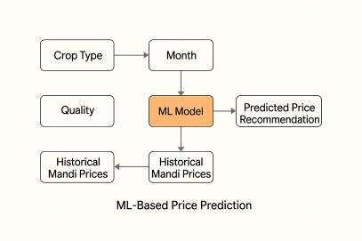
ML-Based Price Prediction Model
The ML model is integrated into the crop upload process on the FARM2MARKET website. As soon as a farmer enters basic crop info (crop name, quantity, location, month), the price prediction engine is triggered.
Component | Description
Algorithm | Linear Regression
Library | Python scikit-learn
Platform | scikit-learn, Trained in Google Colab
Input Features | Crop Type, Month, Historical Mandi Price
Output | Predicted Price per Quintal

Slide 7
FEATURES AND NOVELTY
This project aims to revolutionize the agricultural supply chain by building a digital platform that connects farmers directly with consumers, removing the need for middlemen. This not only ensures better prices for farmers 💰 but also allows customers to buy fresh produce at fair rates 🛒.
FEATURES-
📱 Easy farmer and buyer registration
🌾 Crop upload with details, quantity, and location
🧾 Govt scheme updates in simple Hindi/English
📍 Farmer shown by distance – nearest farmers shown first to buyers
🛒 Buyer section to browse and order crops
🤖ML-Based Price Prediction Model
NOVELTY-
🤝 Smart Tech + Market Access – First-of-its-kind blend of machine learning and direct selling tailored
for Indian farmers.
📊 Data-Driven Decisions – Empowers farmers to plan sales using predicted market trends.
📱 Designed for Rural India – Simple, regional-language interface for ease of use.
🔄 All-in-One Solution – Combines selling, pricing, and information tools under one roof.
🌱 Social Impact – Increases farmer income, promotes transparency, and makes the food system
more sustainable.

Slide 8
DRAWBACK AND SHOWSTOPPERS
📶 Limited Internet Access in Rural Areas: Many farmers still face unreliable internet connectivity, which may limit their access
to the platform.
📱 Low Digital Literacy: Older or less tech-savvy farmers might struggle to use the website, even with a
simplified interface.
🌐 Language and Regional Diversity: Supporting all local languages and dialects can be technically challenging and
time-consuming.
💸 Initial Cost of Awareness and Adoption: Marketing, training, and educating farmers about the platform may require substantial
initial effort and resources.
🔍 Data Availability for ML Model: Accurate and timely mandi price data for all regions may not be readily available,
affecting the performance of the prediction model.
🤝 Trust Issues: Farmers may hesitate to trust an online system due to previous experiences
or fear of online fraud.

Slide 9
TEAM NAME- FARM2MARKET
MEMBER
TTEAM MEMBERS:- CONTACT DETAILS:-
RIDDHIE SENGAR 7770861146
ANUPAM NEMA 7879984284
KOUSHIK PALI 7869495473
DEVANSH PATEL 9302708068

Slide 10
Thank You

